Slide 1

B.Tech Project External Evaluation, VIIIth Sem
Automated Plant Watering System
Presented by :-
Under the Supervision of:-
Shubham Gupta, 2018006327
Shray Sharma, 2018008770
Mukul Rajput, 2018013543
Shaan Raj Pradhan, 2018010540
Ms. Shaveta Khepra, Sharda University, Gr.
Noida
DEPARTMENT OF COMPUTER SCIENCE & ENGINEERING SCHOOL OF ENGINEERING AND TECHNOLOGY
May, 2022
1

Slide 2
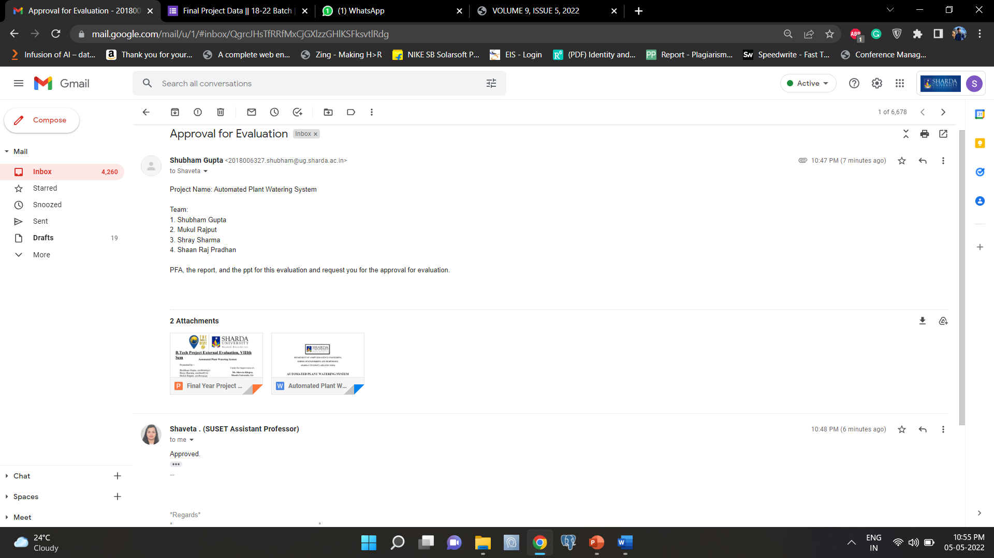
Approval from the guide for the Evaluation

Slide 3
Contents of the Presentation:
Workload Distribution and Project Planning
Project Overview
Technologies used in the Project
Actual Project Images

Slide 4
Workload Distribution of the team
Workload matrix
Mukul Rajput | Hardware management - Will do all the connections and set up of the system
Shubham Gupta | Coding - Design and implement the code for the project Schematics
Shray Sharma | App development - Write code for the project Logic
Shaan Raj Pradhan | Testing and debugging Hardware Presentation

Slide 5
Abstract
The purpose of this research is to create an IoT-based Automated Plant Watering System using various modules such as the Arduino UNO and a moisture sensor. Plant monitoring is one of the most important responsibilities in any agricultural or agriculture setting. It is quite difficult to monitor the plant in certain conditions because human interaction is not accessible 24 hours a day, seven days a week. To solve this problem, the Moisture sensor detects whether the soil is wet or dry, and the sensor readings are sent to the ADC for microcontroller processing. The moisture sensor detects the presence of water and transforms it to an analogue signal that is fed into a small controller through an ADC. If the analogue signal climbs beyond the threshold value, an analog- to-digital converter (ADC) converts it to digital format and provides the water. This IoT device provides peace of mind to the farmer or gardener, as the sensor will automatically display the quantity of moisture content in the soil in the mobile application, where the user can also view a real-time photograph using the camera module. As the security is the major concern in the current world so the mobile application contains a 2-step verification for user login.

Slide 6
Project Overview
This project proposes an automated plant watering system based on Arduino software and hardware, as well as entrepreneurial abilities and traits. It's simply a system that assesses soil moisture with an Arduino soil moisture sensor and then automatically activates a vertical water pump to water the plant when a specified moisture threshold is reached, as programmed in the Arduino IDE. All of the scripts were written using the Arduino IDE application. Part of the hardware is made up of Arduino and generic electronics. Also provides the images of the plant with the use of camera module.

Slide 7
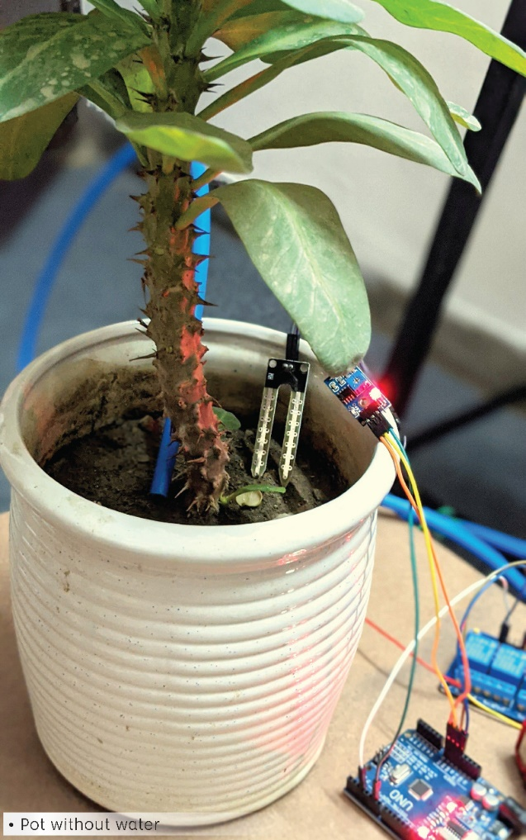
Project Images

Slide 8
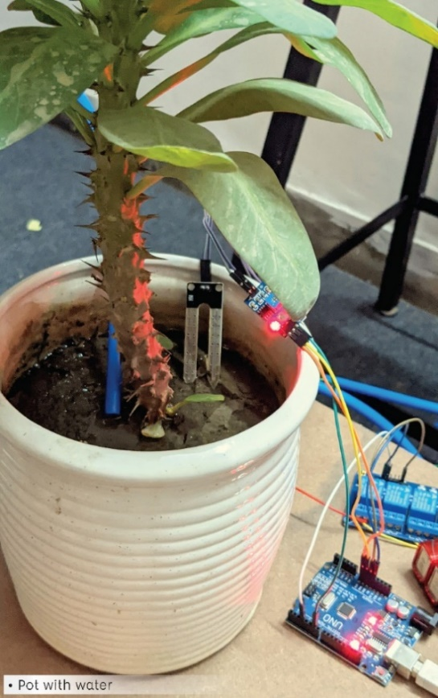
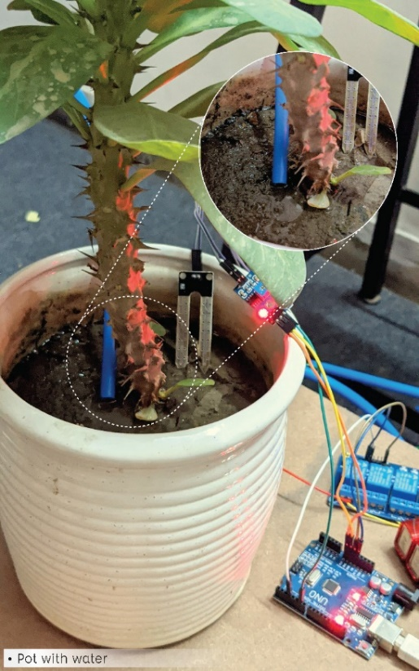

Slide 9
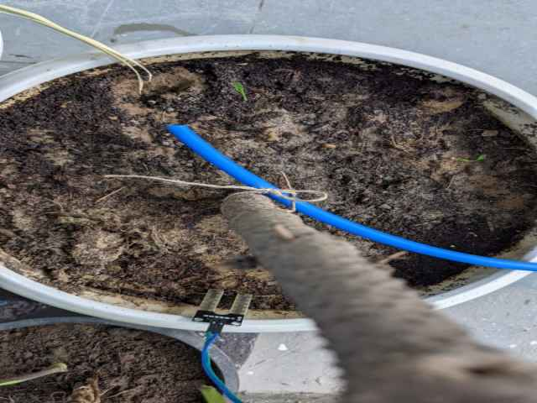
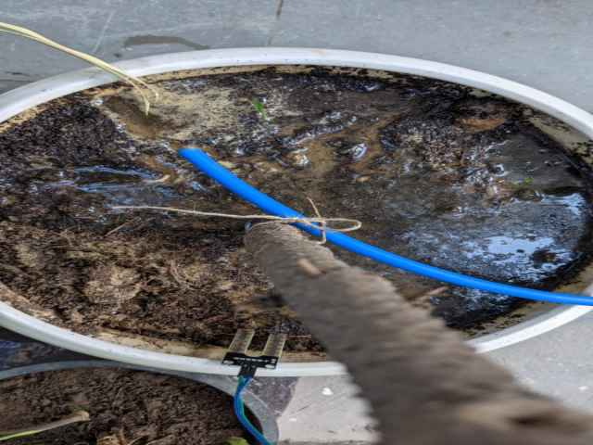
Plant before system is turned on
Plant after water is supplied

Slide 10
THANKYOU

